Slide 1
Chapter 12 Instruction Scheduling

Slide 2
Instruction Scheduling (Engineer’s View)
Optimization has been done
The Instruction Scheduling Problem
Given a code fragment for some target machine and the
latencies for each individual operation, reorder the operations
to minimize execution time
The Concept
The Task
Produce correct code
Minimize wasted cycles
Operate efficiently
Avoid spilling registers
Machine description
slow
code
Scheduler
fast
code
Spill: When the register allocator cannot assign some virtual register to a physical register, it spills the value by storing it to RAM after each definition and loading it into a temporary register before each use.

Slide 3
What Makes Code Run Fast?
Many operations have non-zero latencies
Execution time is order-dependent (and has been since the 60’s)
Modern machines can issue several operations per cycle, we assume one operation per cycle
Operation Cycles
loadAI 3
storeAI 3
loadI 1
add 1
mult 2
fadd 1
fmult 2
shift 1
branch 0 to 8
Loads & stores may or may not block on issue
Non-blocking ⇒ fill those issue slots
Branch costs vary with path taken
Branches typically have delay slots
Fill slots with unrelated operations
Percolates branch upward
Scheduler should hide the latencies

Slide 4
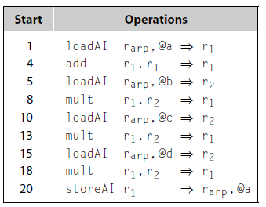
Example
a ← a * 2 * b * c * d
sequential schedule
Operation Cycles
loadAI 3
storeAI 3
loadI 1
add 1
mult 2
fadd 1
fmult 2
shift 1
branch 0 to 8
2 registers, 22 cycles
Reordering operations for speed is called instruction scheduling

Slide 5
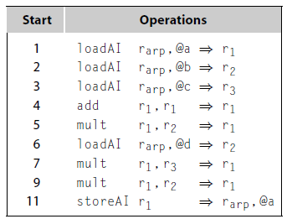
Example
Operation Cycles
loadAI 3
storeAI 3
add 1
mult 2
a ← a * 2 * b * c * d
Original Code
Scheduled Code
2 registers, 22 cycles
3 registers, 13 cycles
Reordering operations for speed is called instruction scheduling

Slide 6

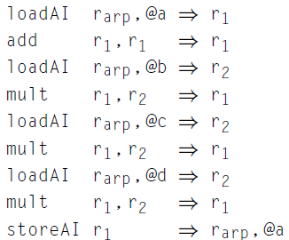
Instruction Scheduling (The Abstract View)
To capture properties of the code, build a precedence graph G
Nodes n ∈ G are operations with type(n) and delay(n)
An edge e = (n₁,n₂) ∈ G if & only if n₂ uses the result of n₁
a
b
c
d
e
f
g
h
i
The Precedence Graph

Slide 7
Instruction Scheduling (Definitions)
A correct schedule S maps each n ∈ N into a non-negative integer representing its cycle number, and
1. S(n) ≥ 1, for all n ∈ N, obviously
2. If (n₁,n₂) ∈ E, S(n₁ ) + delay(n₁ ) ≤ S(n₂ )
3. For each type t, there are no more operations of type t in any cycle than the target machine can issue
The length of a schedule S, denoted L(S), is
L(S) = max_{n ∈ N} (S(n) + delay(n))
The goal is to find the shortest possible correct schedule.
S is time-optimal if L(S) ≤ L(S₁ ), for all other schedules S₁
A schedule might also be optimal in terms of registers, power, or space….

Slide 8
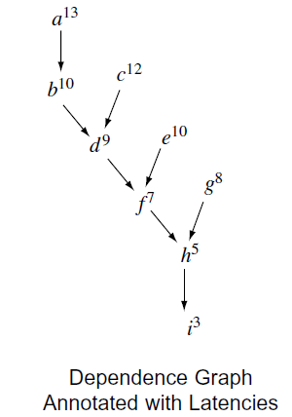
Instruction Scheduling
The path length from a node to the end of the computation is shown as a superscript on the node.
Operation Cycles
loadAI 3
storeAI 3
add 1
mult 2

Slide 9
Instruction Scheduling
From the graph, which operation can/should be scheduled 1st, 2nd? 3rd? …
Critical path: the longest latency path through a dependence graph
An operation can only be scheduled into an
instruction when its operands are available.
Antidependence: Operation x is antidependent on operation y if x precedes y and y defines a value used in x. Reversing their order of execution could cause x to compute a different value.
Denote the antidependence between e and d as e -> d.

Slide 10
Instruction Scheduling
From the graph, which operation can/should be scheduled 1st, 2nd? 3rd? …
Critical path: the longest latency path through a dependence graph
An operation can only be scheduled into an
instruction when its operands are available.
Antidependence: Operation x is antidependent on operation y if x precedes y and y defines a value used in x. Reversing their order of execution could cause x to compute a different value.
Denote the antidependence between e and d as e -> d.

Slide 11
Instruction Scheduling
Antidependence: Operation x is antidependent on operation y if x precedes y and y defines a value used in x. Reversing their order of execution could cause x to compute a different value.
e -> d
e -> c
g -> e
g -> f

Slide 12
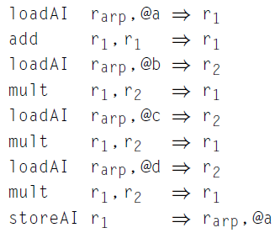




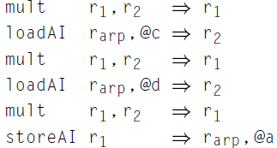
Instruction Scheduling
What to do with antidependencies?
Discover the antidependences in the input code and respect them in the final schedule:
e -> c, e -> d , g -> e , g -> f
2 registers, 22 cycles
2 registers, 19 cycles

Slide 13
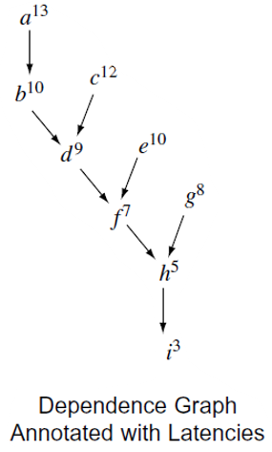
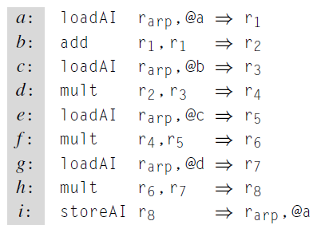
Instruction Scheduling
What to do with antidependencies?
2) Systematically rename the values in the block to eliminate antidependences before it schedules the code
It contains no antidependences, but it creates the potential
problems if the scheduled code requires spill code
Schedule: acebdgfhi 13 cycles

Slide 14
Instruction Scheduling (What’s so difficult?)
Critical Points
Operands can have multiple predecessors
All operands must be available
Multiple operations can be ready
Moving operations can lengthen register lifetimes
Placing uses near definitions can shorten register lifetimes
Together, these issues make scheduling hard (NP-Complete)
Local scheduling is the simple case
Restricted to straight-line code
Consistent and predictable latencies

Slide 15
Instruction Scheduling: Local list scheduling
Local list scheduling
The dominant algorithm
A greedy, heuristic, local technique
1. Rename to avoid antidependences
2. Build a precedence graph, P
3. Compute a priority function over the nodes in P
4. Use list scheduling to construct a schedule, 1 cycle at a time
a. Use a queue of operations that are ready
b. At each cycle
I. Choose the highest priority ready operation & schedule it
II. Update the ready queue
*

Slide 16
Local List Scheduling
Cycle ← 1
Ready ← leaves of P
Active ← Ø
while (Ready ∪ Active ≠ Ø)
for each op ∈ Active
if (S(op) + delay(op) ≤ Cycle) then
remove op from Active
for each successor s of op in P
if (s is ready) then
Ready ← Ready ∪ s
if (Ready ≠ Ø) then
remove an op from Ready
S(op) ← Cycle
Active ← Active ∪ op
Cycle ← Cycle + 1
If successor’s operands are “ready”, add it to Ready
Removal in priority order
op has completed execution
Ready list holds all the operations that can execute in the current cycle
The Active list holds all operations that were issued in an earlier cycle but have not yet finished.

Slide 17
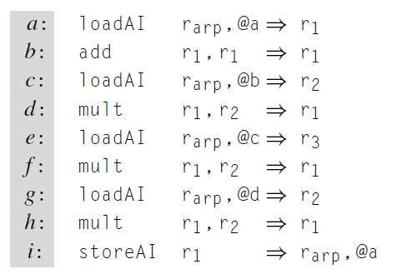
Scheduling Example
1. Rename to avoid antidependences
Used a new register name
The Code

Slide 18
Scheduling Example
Rename to avoid antidependences
Build the precedence graph
a
b
c
d
e
f
g
h
i
The Code
The Precedence Graph

Slide 19
Scheduling Example
Rename to avoid antidependences
Build the precedence graph
Determine priorities: longest latency-weighted path
13
a
12
b
c
10
10
d
e
9
8
f
g
7
5
h
3
i
The Code
The Precedence Graph

Slide 20
Scheduling Example
Rename to avoid antidependences
Build the precedence graph
Determine priorities: longest latency-weighted path
Perform list scheduling
1) a:
l
o
ad
A
I
r
0,
@a
⇒
r
1
a
13
2) c:
l
o
ad
A
I
r
0,
@
b
⇒
r
2
3) e:
l
o
ad
A
I
r
0,
@
c
⇒
r
3
12
b
c
4) b:
a
d
d
r
1,
r
1
⇒
r
1
10
10
5) d:
m
ul
t
r
1,
r
2
⇒
r
1
d
e
9
8
6) g:
l
o
ad
A
I
r
0,
@d
⇒
r
2
g
7) f:
m
ul
t
r
1,
r
3
⇒
r
1
7
f
5
9) h:
m
ul
t
r
1,
r
2
⇒
r
1
h
11) i:
s
t
o
r
e
A
I
r
1
⇒
r
0,
@a
3
i
The Code
The Precedence Graph

Slide 21
Example
Operation Cycles
loadAI 3
storeAI 3
add 1
mult 2
a ← a * 2 * b * c * d
Simple Schedule
Scheduled Code
2 registers, 22 cycles
3 registers, 13 cycles
Reordering operations for speed is called instruction scheduling

Slide 22
Improving the Efficiency of Scheduling
Cycle ← 1
Ready ← leaves of P
Active ← Ø
while (Ready ∪ Active ≠ Ø)
for each op ∈ Active
if (S(op) + delay(op) ≤ Cycle) then
remove op from Active
for each successor s of op in P
if (s is ready) then
Ready ← Ready ∪ s if (Ready ≠ Ø) then
remove an op from Ready
S(op) ← Cycle
Active ¬ Active ∪ op
Cycle ← Cycle + 1
Updating the Ready queue is the most expensive part of this algorithm
Can create a separate queue for each cycle
Add op to queue for cycle when it will complete
Naïve implementation needs too many queues
Can use fewer queues
Number of queues bounded by maximum operation latency
Use them in a cyclic (or modulo) fashion
Detailed algorithm is given at the end of this set of slides

Slide 23
More List Scheduling
List scheduling breaks down into two distinct classes
Variations on list scheduling
Prioritize critical path(s)
Schedule last use as soon as possible
Depth first in precedence graph (minimize registers)
Breadth first in precedence graph (minimize interlocks)
Prefer operation with most successors
Forward list scheduling
Start with available operations
Work forward in time
Ready ⇒ all operands available
Backward list scheduling
Start with no successors
Work backward in time
Ready ⇒ latency covers uses

Slide 24
Local Scheduling
Dependence Graph for a Block from SPEC benchmark “go”
Latency to the cbr
8
8
8
8
8
loadI₁
lshift
loadI₂
loadI₃
loadI₄
7
7
7
7
6
add₁
add₂
add₃
add₄
addI
Subscript to identify
2
5
5
5
5
5
cmp
store₁
store₂
store₃
store₄
store₅
1
cbr
Operation | load | loadI | add | addI | store | cmp
Latency | 1 | 1 | 2 | 1 | 4 | 1
Forward and backward can produce different results

Slide 25
Local Scheduling
ILOC machine with two integer functional units
and one unit to perform memory operations.
F
o
r
w
a
r
d
S
c
h
e
d
u
l
e
 | Int | Int | Mem
1 | loadI₁ | lshift
2 | loadI₂ | loadI₃
3 | loadI₄ | add₁
4 | add₂ | add₃
5 | add₄ | addI | store₁
6 | cmp |  | store₂
7 |  |  | store₃
8 |  |  | store₄
9 |  |  | store₅
10
11
12
13 | cbr
B
a
c
k
w
a
r
d
S
c
h
e
d
u
l
e
 | Int | Int | Mem
1 | loadI₄
2 | addI | lshift
3 | add₄ | loadI₃
4 | add₃ | loadI₂ | store₅
5 | add₂ | loadI₁ | store₄
6 | add₁ |  | store₃
7 |  |  | store₂
8 |  |  | store₁
9
10
11 | cmp
12 | cbr
Using “latency to root” as the priority function

Slide 26
List Scheduling Variant
Schielke’s RBF Algorithm
Recognize that forward & backward both have their place
Recognize that tie-breaking matters & that, while we can rationalize various tie-breakers, we do not understand them
Part of approximating the solution to an NP-complete problem
The Algorithm
Run forward scheduler 5 times, breaking ties randomly
Run backward scheduler 5 time, breaking ties randomly
Keep the best schedule
RBF means “randomized backward & forward”
The implementation must be scrupulous about randomizing all choices.

Slide 27
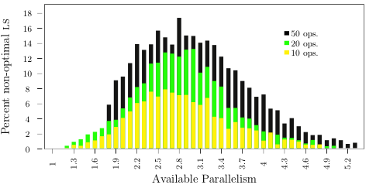
How Good is List Scheduling? Schielke’s Study
85,000 randomly generated blocks
RBF found optimal schedules for > 80%
Peak difficulty (for RBF) is around 2.8
Tie-breaking matters because it affects the choice when queue has > 1 element
3 compute months of work
Non-optimal list schedules (%) versus available parallelism
1 functional unit, randomly generated blocks of 10, 20, 50 ops

Slide 28
Detailed Scheduling Algorithm I
Idea: Keep a collection of worklists W[c], one per cycle
We need MaxC = max delay + 1 such worklists
Precedence graph is (N,E)
Code:
for each n ∈ N do begin count[n] := 0; earliest[n] = 0 end
for each (n1,n2) ∈ E do begin
count[n2] := count[n2] + 1;
successors[n1] := successors[n1] ∪ {n2};
end
for i := 0 to MaxC – 1 do W[i] := ∅;
Wcount := 0;
for each n ∈ N do
if count[n] = 0 then begin
W[0] := W[0] ∪ {n}; Wcount := Wcount + 1;
end
c := 0; // c is the cycle number
cW := 0;// cW is the number of the worklist for cycle c
instr[c] := ∅;

Slide 29
Detailed Scheduling Algorithm II
while Wcount > 0 do begin
while W[cW] = ∅ do begin
c := c + 1; instr[c] := ∅; cW := mod(cW+1,MaxC);
end
nextc := mod(c+1,MaxC);
while W[cW] ≠ ∅ do begin
select and remove an arbitrary instruction x from W[cW];
if ∃ free issue units of type(x) on cycle c then begin
instr[c] := instr[c] ∪ {x}; Wcount := Wcount - 1;
for each y ∈ successors[x] do begin
count[y] := count[y] – 1;
earliest[y] := max(earliest[y], c+delay(x));
if count[y] = 0 then begin
loc := mod(earliest[y],MaxC);
W[loc] := W[loc] ∪ {y}; Wcount := Wcount + 1;
end
end
else W[nextc] := W[nextc] ∪ {x};
end
end
Priority

